Slide 1






Practical Example
How to generate a RV with desired distribution
U is uniform over [0,1], how do we turn it into an exponential RV?
Can transform a uniform RV into any distribution using inverse CDF!

Slide 3


Example
Ratio of two independent exponential RVs

Slide 4
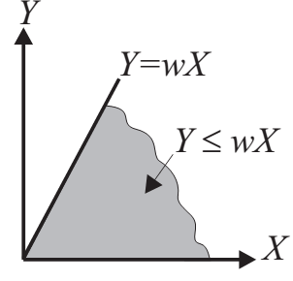
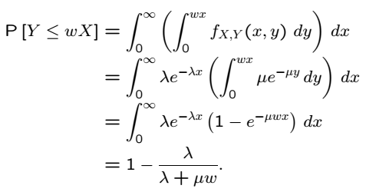
Solution
Ratio of two independent exponential RVs

Slide 5
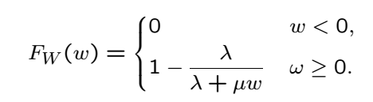
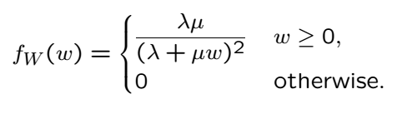
Solution Cont’
Ratio of two independent exponential RVs

Slide 6
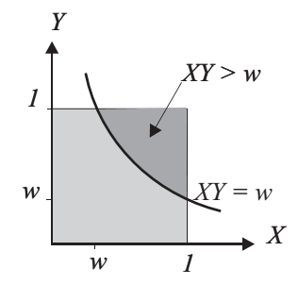

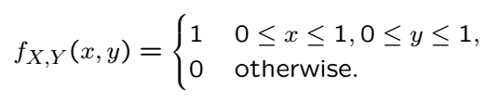
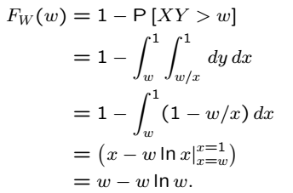

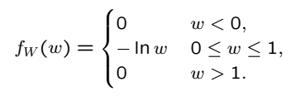
Example: Product of Two RVs
Product of two RVs

Slide 7
Acknowledgements and Citations
Parts of these slides are adapted from the following resources:
Power Point Lecture Slides for the Textbook http://bcs.wiley.com/hebcs/Books?action=index&bcsId=8676&itemId=1118324560
John Tsitsiklis. 6.041 Probabilistic Systems Analysis and Applied Probability, Fall 2010. (Massachusetts Institute of Technology: MIT OpenCourseWare),http://ocw.mit.edu (Accessed 13 Apr, 2015). License: Creative Commons BY-NC-SA

